Slide 1

REACT.JS
Ireri Petersen – WDD 230

Slide 2
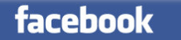
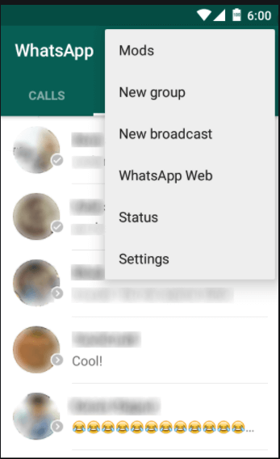

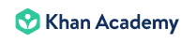


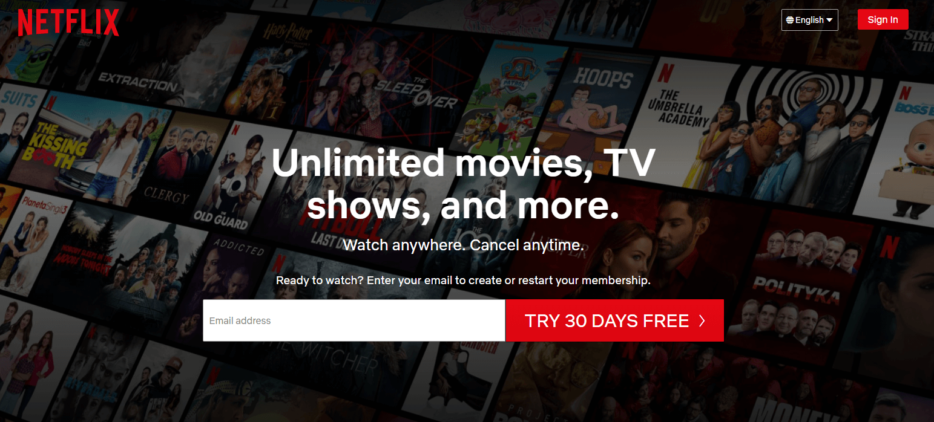
What is react?
React.JS is a front-end JavaScript library used to create and build interactive user interfaces.
Mostly used for web and mobile applications
Maintained and created by Facebook
Initial release to the public: May 2013
Many famous companies besides Facebook use React or React Native for their websites and Mobile apps: Whatsapp, Instagram, Khan Academy, Netflix, Discord, Dropbox, etc.

Slide 3
Why should you learn to use react?
Faster interface rendering (faster load time) due to the use of JSX and Virtual DOM
Easy to use
Ability to reuse code
Besides the advantages of using React, it’s used by a large percentage of developers (according to Web Technology Surveys, React is used by about 46% of all the world’s websites). Most front-end development jobs include React.js as a required or preferred skill. This is true for both web- and mobile-app focused job positions.

Slide 4
How to use react
Make sure to import the React.js library as shown.
You may need to install the library onto your computer first depending on your text editor.
Create a class in JavaScript that “extends” the base React.Component class.
See the <div></div> that look exactly like an HTML div tag? This is react’s JSX syntax, which stands for JavaScript XML. This allows react to create a Virtual DOM, which then means that instead of needing to refresh the entire webpage or screen when this function is called, react will only refresh and change the specific parts of the document that you specify here with JSX. So in this case, the program will only refresh this div element. This is what makes load and page/event rendering times so quick with React.js!
The render() method takes input data and returns what to display.
This is where you call the class (in this case “HelloMessage”) using JSX syntax within the render() method/function, and input/set the data that you want to display.
Result: “Hello Taylor”

Slide 5
Simple example: Forms
https://codepen.io/ireri-school/pen/MWeGMMa

Slide 6
More advanced examples
Photo Slider by Joseph Martucci: https://codepen.io/jjmartucci/pen/MwLxor
Programming Language Hangman: https://reactjs-hangman.netlify.com/ | https://github.com/vetrivelcsamy/reactjs-hangman
Windows ‘95 style PokeDex: https://poke95.now.sh/ | https://github.com/sorxrob/poke95
Online Memory card game: https://svsem.github.io/Memorai/ | https://github.com/svsem/Memorai

Slide 7
Thanks for watching!
SUGGESTED FREE TUTORIALS FOR REACT.JS:
The official React.js site tutorial: https://reactjs.org/tutorial/tutorial.html
The Beginner’s Guide to React by Kent C. Dodds: https://egghead.io/courses/the-beginner-s-guide-to-react
Codecademy’s free intermediate React course: https://www.codecademy.com/learn/react-101
W3 Schools Tutorial: https://www.w3schools.com/react/default.asp
Sources:
https://blog.risingstack.com/the-history-of-react-js-on-a-timeline/
https://reactjs.org/
https://skillcrush.com/blog/what-is-react-js/
https://selleo.com/blog/top-10-companies-using-reactjs
https://www.w3schools.com/react/react_forms.asp
https://www.simform.com/why-use-react/
https://www.reddit.com/r/reactjs/

